Slide 1


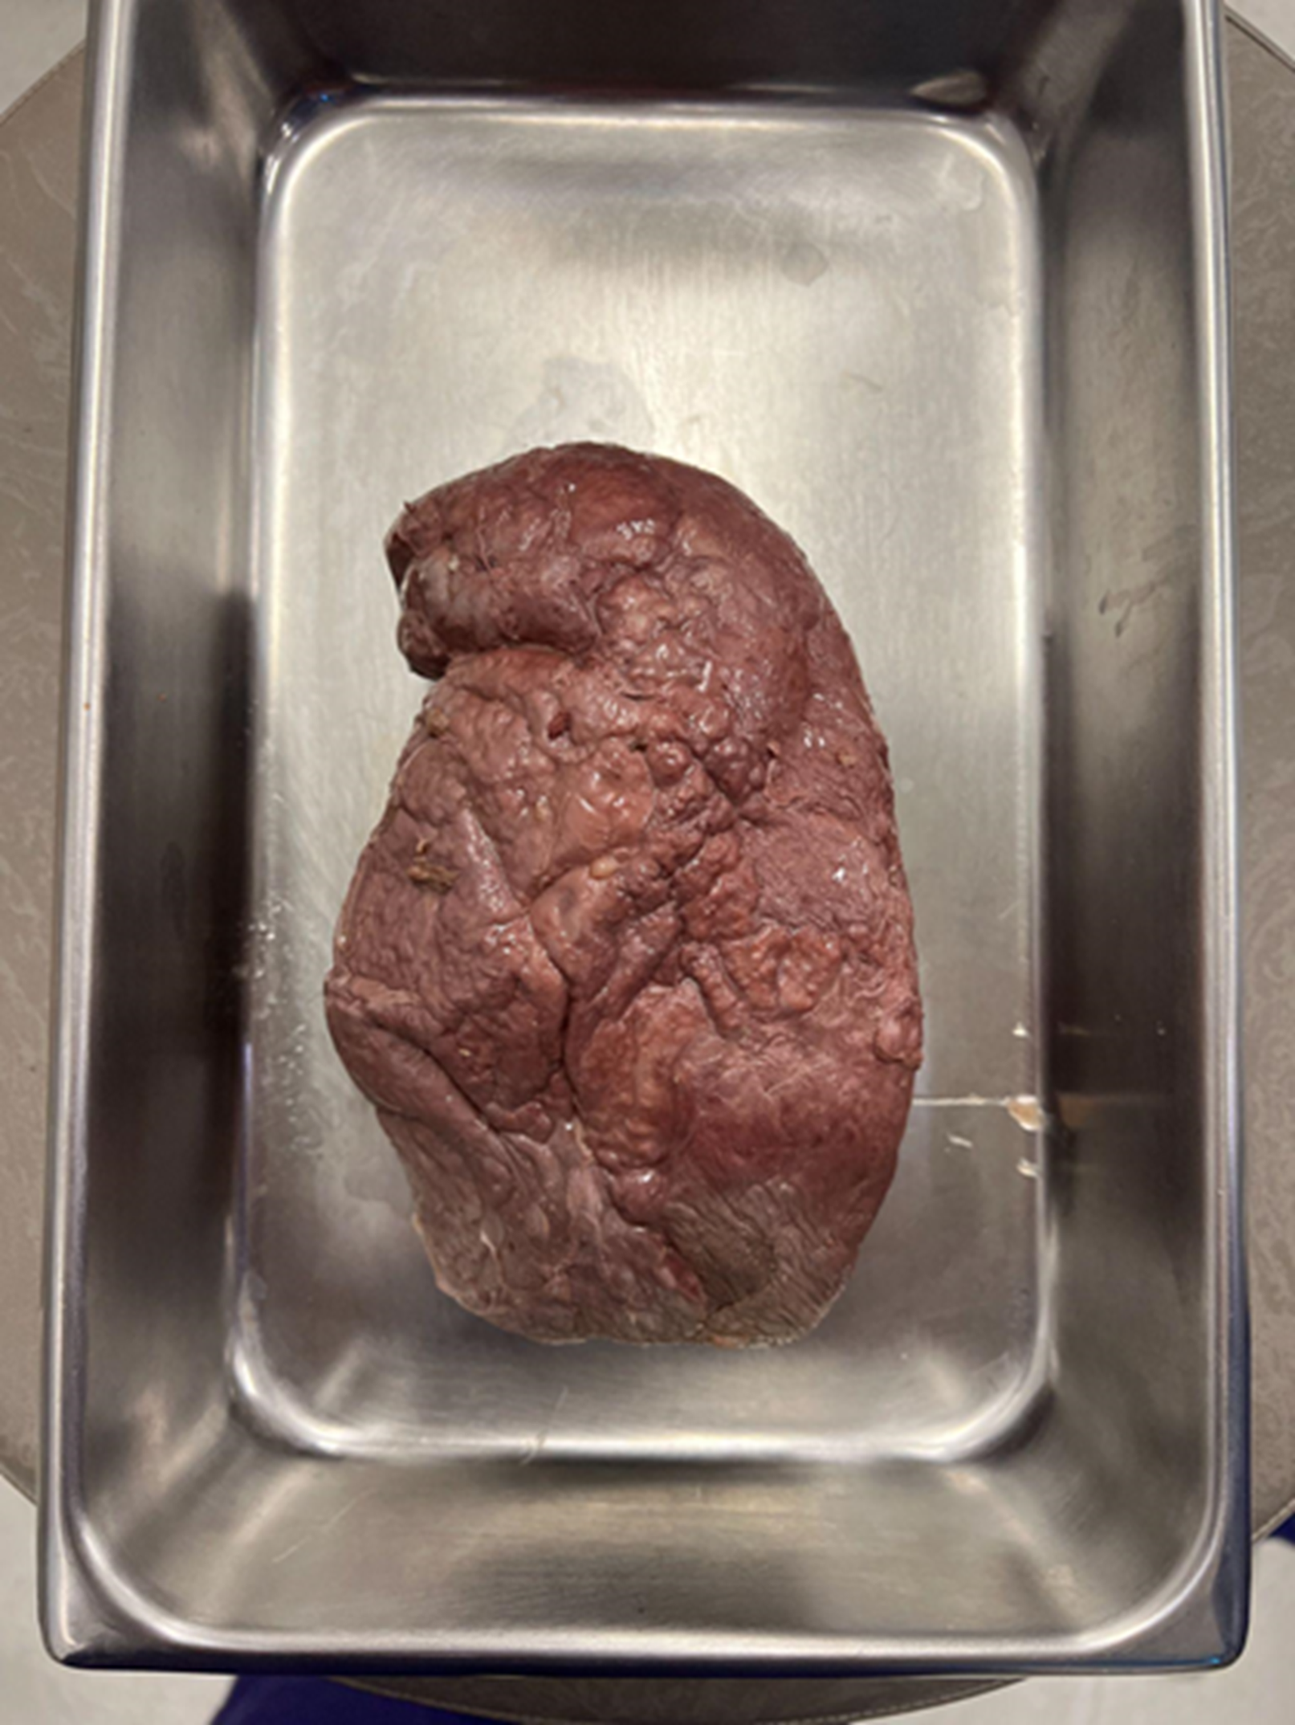
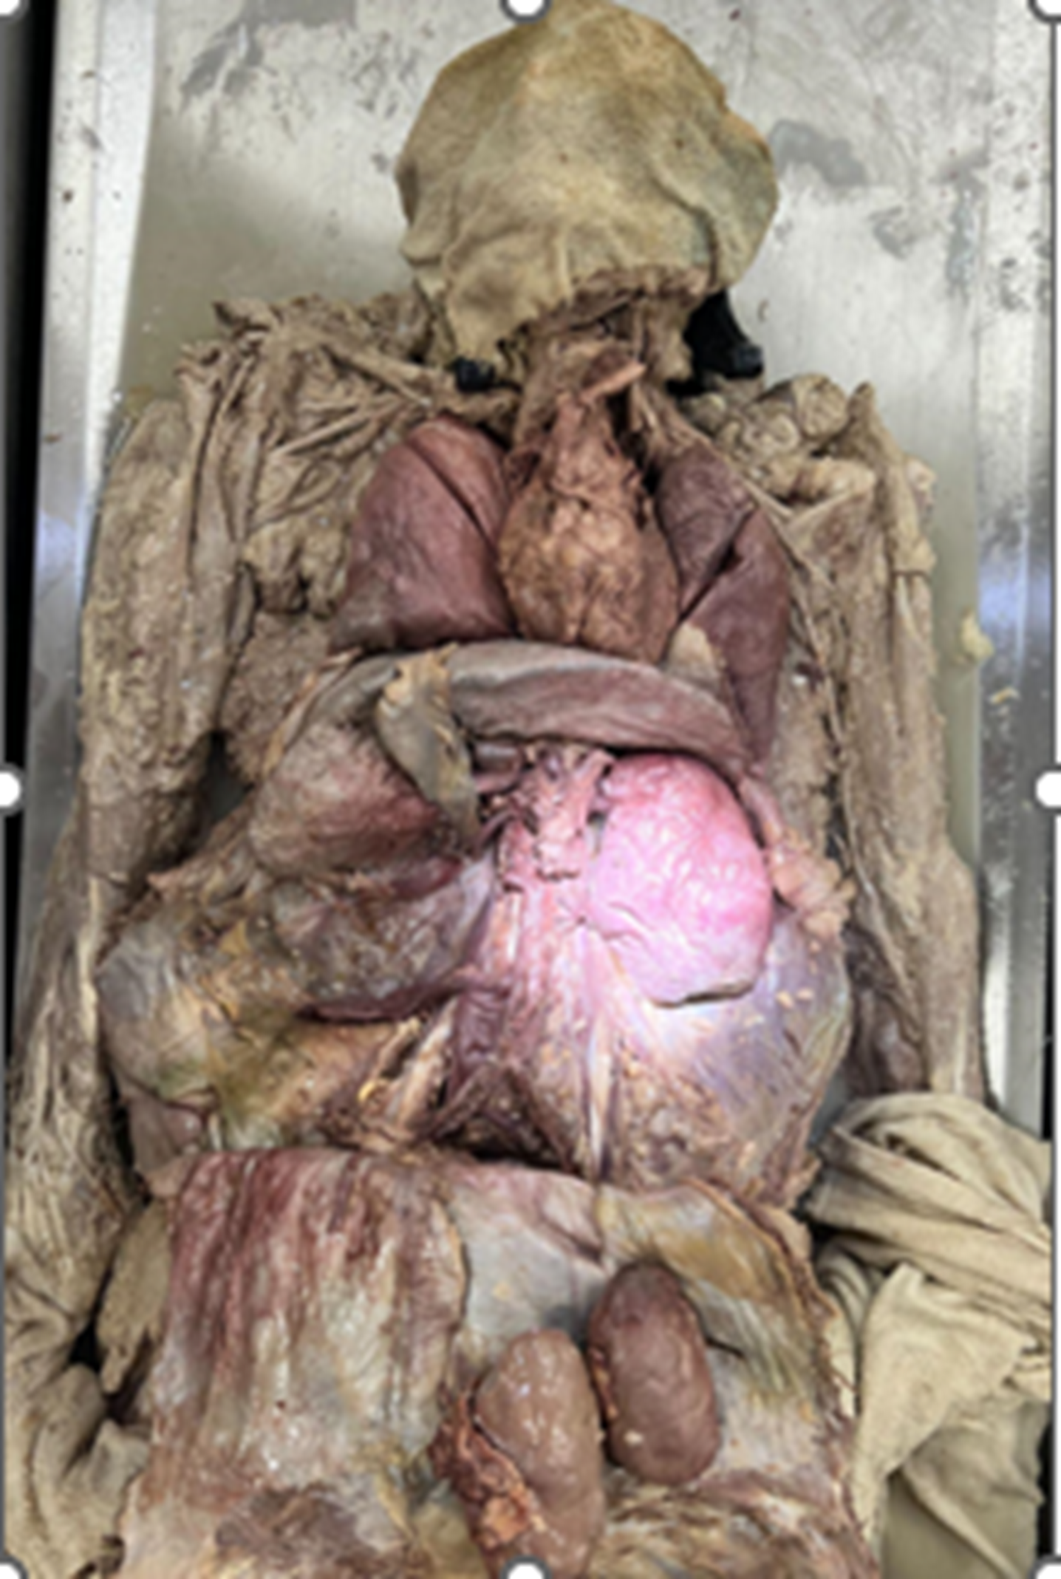
SPLENOMEGALY: DEVELOPING A
FRAMEWORK FOR DIFFERENTIAL DIAGNOSIS
Rutland M, Holcomb B., Weaver C., Wilson C., Sherrow RJ.
Hardin-Simmons University, Department of Physical Therapy
Abilene, TX, 79601 USA
Figure 1: Enlarged Spleen
INTRODUCTION/PUPROSE:
First-year DPT students learn anatomy through dissection of human donors. The age, occupation, and the cause of death are the sole medical history provided; therefore, other conditions are often discovered by students throughout the dissection. Upon dissecting the donor’s organ system, students discovered massive splenomegaly and hepatomegaly. This discovery led students to investigate splenomegaly and potential causes and symptoms.
MATERIALS & METHODS:
A 67-year-old embalmed female human donor was dissected by DPT students over 8 months. The cause of death was renal failure. Upon dissection of the abdominal organs, massive splenomegaly was noted. measuring 16.9 cm (length), 9.7 cm (width), and 7.25 cm(height), weighing 525 grams. Additionally, an enlarged liver which spanned to the left thoracic wall, measuring 30.9 cm(length) x 14.5 cm(width) x 11 cm(height) was present.
RESULTS: Additionally, the spleen (525 grams) was classified as grade 4 splenomegaly, as the normal weight of the adult spleen in 70g to 200 g, with spleen weight of 400 -500 grams indicating splenomegaly. Massive splenomegaly included a weight greater than 1000 grams, and a length greater than 20 cm.
CONCLUSIONS: Through critical thinking, students speculated symptoms and causes anticipated with splenomegaly. Health care clinicians should recognize signs/symptoms evident of possible splenomegaly. The anatomic variation of an irregular spleen and liver encouraged students to analyze and hypothesize clinical presentations.
REFERENCES:
Scaramellini N, Croci G, De Magistris C, et al. Splenomegaly: Dare to think rare. Am J Hematol. 2022;97(9):1259-1265. doi:10.1002/ajh.26559
Aldulaimi S, Mendez AM. Splenomegaly: Diagnosis and Management in Adults. Amer Fam Phys. 2021. 104(3): 271-276.
Storment T, Tathireddy H, Huckaby R, Shatzel JJ. A Comprehensive Investigation into the Underlying Etiology of Massive Splenomegaly. Blood. 2023; 142(supplement 2: 7330 . https://doi.org/10.1182/blood-2023-190274
Figure 1: Enlarged Spleen
Figure 2: Enlarged Liver
SYMPTOMS:
Flulike symptoms
Sore throat
Abdominal pain
Fever
Weight loss
Night sweats, Fatigue
Bleeding,
Easily bruised
Pallor
Jaundice
Possible petechial rashes
POTENTIAL CAUSES of SPLENOMEGALY
Heart failure: advanced liver disease, portal hypertension, renal failure, splenic vein thrombosis
Neoplastic: tumors
Infections: Hepatitis, HIV, splenic abscess
Tropical/parasitic/consideration: Malaria (high malaria regions have a greater prevalence of splenomegaly (80%)
Autoimmune/inflammatory
Hematologic disorders
Infiltrative (nonmalignant,
noninfectious) or cancer
We gratefully thank those donors who have unselfishly shared their body for our education..

