Slide 1
The Functions of Behavior
and
How It Can Help in Your Classroom
by Julia Smith, M.Ed., BCBA, LBA

Slide 2
Today’s Objectives
Review of Foundations of ABA (defining behavior and identifying behaviors to target)
The 4 functions of behavior
ABC recording and analysis
Identifying the function of challenging behavior

Slide 3
Behavior
Behavior :
  An observable and measurable act of a person
  (You can see it or hear it, count it or time it)
Behavior is not:
  Feelings or emotions

Slide 4
Is it Behavior?
  Behavior
  Crying
  Spitting
  Hitting
  Rocking
  Laughing
  Not Behavior
  Mad
  Anxious
  Happy
  Agitated
  Frustrated

Slide 5
Behavior
It is important to define behavior in a way that
describes what it looks like,
not what we suspect it means or how we
suspect the person feels.

Slide 6
Discussion
Since the last training, have you thought of new behaviors of concern that you wanted to target for reduction? How did you decide what you wanted to target?

Slide 7

Identifying Behavior to Target for Reduction
Behavior that is dangerous to child or others
Behavior that interferes with participation in meaningful activities
Behavior that disrupts others and prevents them from participating in meaningful activities
Behavior that is stigmatizing (likely to prevent a child from being included)

Slide 8
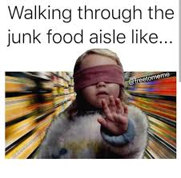
Not all unusual or annoying behavior needs to be targeted for reduction
Junk behavior

Slide 9

The Functions of Behavior

Slide 10
Discussion
Why do students engage in challenging behavior?

Slide 11
Now, let’s get personal…
Why do you and I behave the way we do?

Slide 12
The answer:
It works for us!!
We have learned through our experiences and through conditioning what is effective in getting our needs and desires met.
We also do what we are motivated to do, what we find enjoyable, and what is reinforcing to us.

Slide 13
The Functions of Behavior
All behavior serves a purpose
for the person who does it

Slide 14
The Functions of Behavior
Behavior is repeated because the consequences are desirable
We engage in behavior in ways that get us what we want, or help us avoid or escape things we don’t want

Slide 15
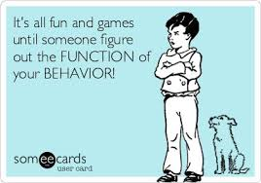
The 4 Functions of Behavior
To get attention
To get access to an item or activity
To escape or avoid something
Sensory Stimulation

Slide 16
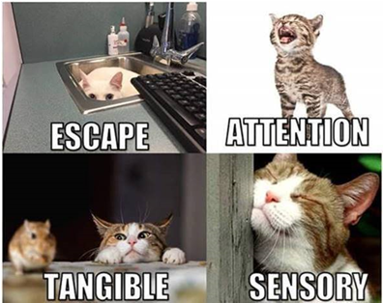
The 4 Functions of Behavior

Slide 17
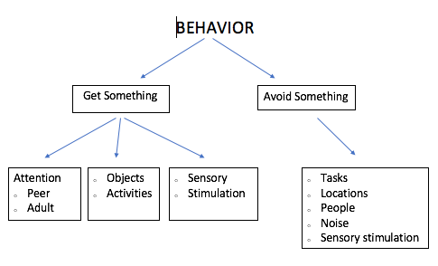
The Functions of Behavior

Slide 18
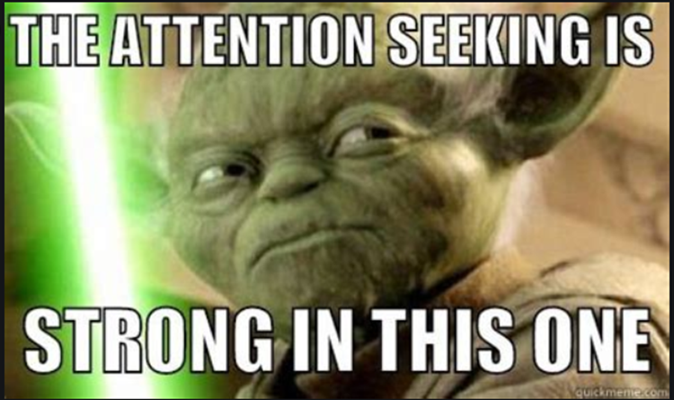
Attention
Behavior that results in immediate attention from others
  This can be “positive” or “negative” attention
Examples:
  Saying “Excuse me?” and Mom looks at you
  Taking your sister’s toy and she chases you
  Throwing papers and your teacher yells at you
  Crying and mom cuddles you
  Running away, and turning to see if teacher is following you

Slide 19
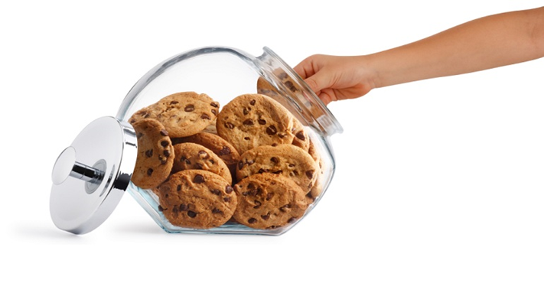
Access to Items
Behavior that results in getting preferred objects, items, or activities
Examples:
  Grabbing a toy from a peer
  Asking for a snack or candy
  Leaving circle time and going to play with trains
  Climbing a cabinet to get a game
  Saying “push me higher” and dad pushes you on swing

Slide 20
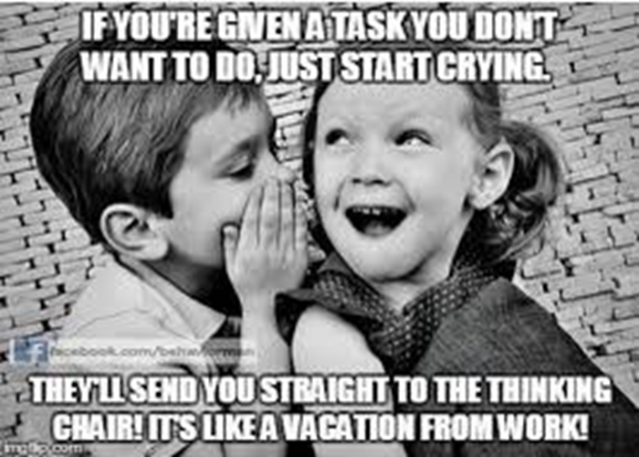
Avoidance/Escape
Behavior that results in ending or delaying disliked events
Examples:
  Complete chores; mom stops nagging
  Complete assignment; avoid homework later
  Hang up phone when telemarketer calls; conversation stops
  Flop to the floor; delay coming in from recess
  Hit peers; escape group work/circle time
  Throw a tantrum; avoid going to the bathroom

Slide 21
Automatic
Behaviors that are fun by themselves; they feel good, look fun, smell cool, etc.
  Typically things that happen when child is alone or all the time no matter where they are
Examples:
  Hand flapping, body rocking, flicking fingers by eyes
  Making noises, reciting lines from movies, humming
  Spinning wheels on a car, opening and closing door repeatedly, playing with string, banging hangers together
  Going for a run, rubbing your temples, twirling your hair, scratching an itch, tapping your foot, fidget spinners

Slide 22
Discussion
Do you engage in any behavior that doesn’t fit in to one of these categories?

Slide 23
Identifying the Function of
Problem Behavior

Slide 24
The Behavioral Event
To understand behavior, we have to know the whole story (beginning, middle, end)
A description of the behavior alone is not sufficient.

Slide 25
ABC Recording
ABC data helps identify
The events or conditions that make the target behavior more likely to be exhibited.
The events that precede or “trigger” the target behavior.
The consequences that maintain the behavior (the purpose of the behavior).

Slide 26
ABC Analysis
1. Identify the behavior

Slide 27
ABC Analysis
2. Identify the antecedent and the consequence

Slide 28
Maria is at the table with a classmate and her teacher. Her teacher is talking to her classmate about her her upcoming birthday party. Maria begins to yell, bang on the table, and throw her materials. Her teacher sits down with her, holds her hands, and offers reassurance.
Antecedent | Behavior | Consequence
Teacher is talking to a classmate | Maria yells, hits table, throws materials | Teacher sits with her and talks to her
What function would a pattern of behavior like this suggest?

Slide 29
When Joey is given a math assignment, he gets out of his desk, runs around the room and knocks classmates books and papers on the floor. An administrator is called to remove him from the classroom.
Antecedent | Behavior | Consequence
Given a math assignment | Joey gets up, walks around class throws materials | Removed from class
What function would a pattern of behavior like this suggest?

Slide 30
Sam tries to run from the cafeteria repeatedly as soon as he finishes his lunch. He is given an iPad and walked back to the table.
Antecedent | Behavior | Consequence
Finishes lunch | Sam attempts to run from cafeteria | Given iPad and returned to table
What function would a pattern of behavior like this suggest?

Slide 31
When the class starts dribbling basketballs in the gym, Jose sits, covers his ears with his hands, and rocks back and forth.
Antecedent | Behavior | Consequence
Classmates start bouncing basketballs n the gym | Jose sits, covers ears, rocks | Lessens volume of the basketballs
What function would a pattern of behavior like this suggest?

Slide 32
Practice
ABC Data

Slide 33
Identifying Function
1. Review the antecedents to identify when the behavior is most likely to occur
2. Review the consequences to identify what reinforces the target behavior (the purpose it serves/the function)
  Attention
  Tangibles
  Escape
  Sensory stimulation

Slide 34
Practice
ABC Review and Identifying Function

Slide 35
References
  Cooper, J.O., Heron, T.E., Heward, W.L. (2007). Applied behavior analysis (2nd Ed.). Upper Saddle, New Jersey: Pearson.

Slide 36

Thank you!
Julia Smith, M.Ed., BCBA, LBA
julia.smith@abileneisd.org
juliasmith060@gmail.com

