Slide 1
Antecedent-Based Interventions
in Your Classroom
by Julia Smith, M.Ed., BCBA, LBA

Slide 2
Today’s Objectives
Review of Foundations of ABA (defining behavior and identifying behaviors to target)
Review the 4 functions of behavior
Identify antecedent-based interventions based on the function of behavior

Slide 3
Behavior
Behavior :
  An observable and measurable act of a person
  (You can see it or hear it, count it or time it)
Behavior is not:
  Feelings or emotions

Slide 4
Behavior
It is important to define behavior in a way that
describes what it looks like,
not what we suspect it means or how we
suspect the person feels.

Slide 5
Discussion
Since the last training, have you thought of new behaviors of concern that you wanted to target for reduction? How did you decide what you wanted to target?

Slide 6

Identifying Behavior to Target for Reduction
Behavior that is dangerous to child or others
Behavior that interferes with participation in meaningful activities
Behavior that disrupts others and prevents them from participating in meaningful activities
Behavior that is stigmatizing (likely to prevent a child from being included)

Slide 7
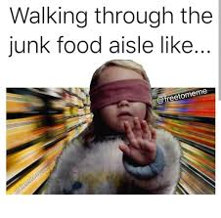
Not all unusual or annoying behavior needs to be targeted for reduction
Junk behavior

Slide 8

The Functions of Behavior

Slide 9
The Functions of Behavior
All behavior serves a purpose
for the person who does it

Slide 10
The Functions of Behavior
Behavior is repeated because the consequences are desirable
We engage in behavior in ways that get us what we want, or help us avoid or escape things we don’t want

Slide 11
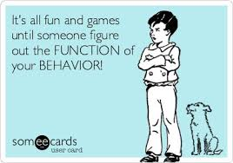
The 4 Functions of Behavior
To get attention
To get access to an item or activity
To escape or avoid something
Sensory Stimulation

Slide 12
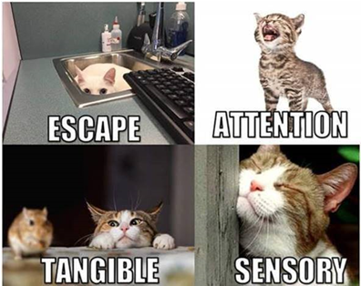
The 4 Functions of Behavior

Slide 13
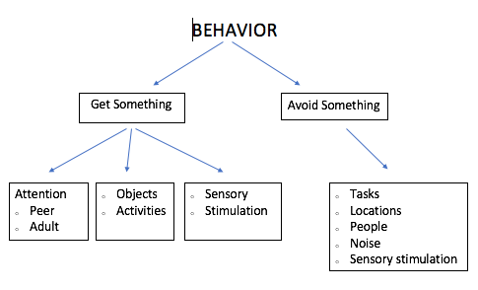
The Functions of Behavior

Slide 14

Attention
Behavior that results in immediate attention from others
  This can be “positive” or “negative” attention
Examples:
  Saying “Excuse me?” and Mom looks at you
  Taking your sister’s toy and she chases you
  Throwing papers and your teacher yells at you
  Crying and mom cuddles you
  Running away, and turning to see if teacher is following you

Slide 15
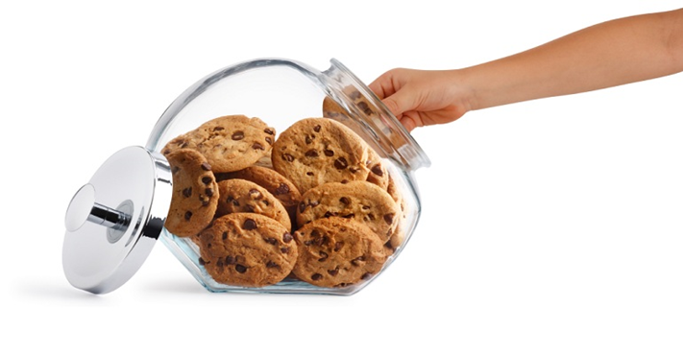
Access to Items
Behavior that results in getting preferred objects, items, or activities
Examples:
  Grabbing a toy from a peer
  Asking for a snack or candy
  Leaving circle time and going to play with trains
  Climbing a cabinet to get a game
  Saying “push me higher” and dad pushes you on swing

Slide 16
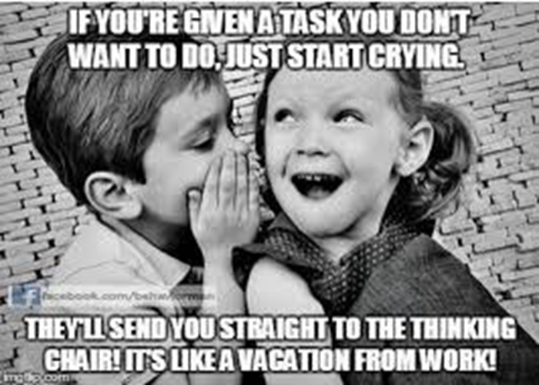
Avoidance/Escape
Behavior that results in ending or delaying disliked events
Examples:
  Complete chores; mom stops nagging
  Complete assignment; avoid homework later
  Hang up phone when telemarketer calls; conversation stops
  Flop to the floor; delay coming in from recess
  Hit peers; escape group work/circle time
  Throw a tantrum; avoid going to the bathroom

Slide 17
Automatic
Behaviors that are fun by themselves; they feel good, look fun, smell cool, etc.
  Typically things that happen when child is alone or all the time no matter where they are
Examples:
  Hand flapping, body rocking, flicking fingers by eyes
  Making noises, reciting lines from movies, humming
  Spinning wheels on a car, opening and closing door repeatedly, playing with string, banging hangers together
  Going for a run, rubbing your temples, twirling your hair, scratching an itch, tapping your foot, fidget spinners

Slide 18
Identifying the Function of
Problem Behavior

Slide 19
The Behavioral Event
To understand behavior, we have to know the whole story (beginning, middle, end)
A description of the behavior alone is not sufficient.

Slide 20
ABC Recording
ABC data helps identify
The events or conditions that make the target behavior more likely to be exhibited.
The events that precede or “trigger” the target behavior.
The consequences that maintain the behavior (the purpose of the behavior).

Slide 21
ABC Analysis
1. Identify the behavior

Slide 22
ABC Analysis
2. Identify the antecedent and the consequence

Slide 23
Function Based Interventions
Three areas of intervention
Antecedent | Behavior | Consequence
Prevention strategies | Replacement behavior | Response to challenging behavior

Slide 24

Antecedent Interventions
(prevention strategies)

Slide 25
Antecedent Interventions
Reinforce appropriate alternative behavior (replacement behaviors)
Eliminate or decrease motivation to engage in challenging behavior
Alter setting events, environment, or specific antecedents

Slide 26
Function Based Antecedent Interventions
Antecedent Interventions are most effective
when selected based on function of the problem behavior

Slide 27
Discussion
Maria is at the table with a classmate and her teacher. Her teacher is talking to her classmate about her her upcoming birthday party. Maria begins to yell, bang on the table, and throw her materials. Her teacher sits down with her, holds her hands, and offers reassurance.

Slide 28
Behavior that functions to Gain Attention
Reinforce appropriate alternative behavior (replacement behaviors)
Appropriate attempts to gain attention Sharing attention Waiting for attention (not interrupting)
Alter setting events, environment, or specific antecedents
Provide an alternative source of reinforcement when attention will not be available (distraction) Included the student in conversation with others Use proximity as a form of attention (stand next to student’s desk when addressing class)
Eliminate or decrease motivation to engage in challenging behavior
Provide attention regularly for free – on a schedule that is a little more frequent than the student seeks attention
Notes:
What if the function is peer attention?
Peer attention vs. adult attention vs. specific person’s attention

Slide 29
What if the student wants other students’ attention?
How can you use these strategies in your classroom?

Slide 30
Discussion
Sam tries to run from the cafeteria repeatedly as soon as he finishes his lunch. He is given an iPad and walked back to the table.

Slide 31
Behavior that functions to Gain Access to Items / Activities
Reinforce appropriate alternative behavior (replacement behaviors)
Appropriate requests for item/activity Accepting an alternative when item is not available Waiting for item, taking turns with item
Alter setting events, environment, or specific antecedents
First/then prompting Visual schedules or cues Warnings prior to ending highly preferred activities
Eliminate or decrease motivation to engage in challenging behavior
Provide regularly scheduled access to desired item for free

Slide 32
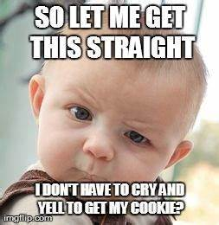
Notes:
How can you use these strategies in your classroom?

Slide 33
Discussion
When Joey is given a math assignment, he gets out of his desk, runs around the room and knocks classmates' books and papers on the floor. An administrator is called to remove him from the classroom.

Slide 34
Behavior that functions to Escape or Avoid Demands
Reinforce appropriate alternative behavior (replacement behaviors)
Appropriate requests to escape or avoid (request to leave an area, take a break, etc.)
Alter setting events, environment, or specific antecedents
Make sure the demand is appropriate for the student (is the student capable) Reduce the number of demands, reduce the effort required Increase the pace of instruction Mix easy and difficult tasks Use errorless teaching, provide prompts and direct instruction Provide choices
Eliminate or decrease motivation to engage in challenging behavior
Decrease demands Provide frequent breaks
Notes:
But if we give them a break, they are getting out of their work they are escaping??
Discuss the “break” they get when they display aggression and property destruction

Slide 35
Discussion
When the class starts dribbling basketballs in the gym, Jose sits, covers his ears with his hands, and rocks back and forth.
Reinforce appropriate alternative behavior
Eliminate or alter specific antecedents
Decrease motivation to engage in problem behavior

Slide 36
Behavior that functions to Provide or Alter Sensory Input
Reinforce appropriate alternative behavior (replacement behaviors)
Reinforce appropriate toy play, physical activity Provide an appropriate way to get the same reinforcing sensory input (example - chewy necklace, fidget toy, rocking chair)
Alter setting events, environment, or specific antecedents
Limit exposure to aversive sensory input (avoid) Provide a way to minimize (sound cancelling headphones for loud areas, sunglasses for bright light)
Eliminate or decrease motivation to engage in challenging behavior
Schedule a routine time / location for stereotypic behavior Reinforce tolerance with access to highly preferred items/activities

Slide 37
References
  Cooper, J.O., Heron, T.E., Heward, W.L. (2007). Applied behavior analysis (2nd Ed.). Upper Saddle, New Jersey: Pearson.

Slide 38

Thank you!
Julia Smith, M.Ed., BCBA, LBA
julia.smith@abileneisd.org
juliasmith060@gmail.com

